Slide 1
ENG 346
Data Structures and Algorithms for Artificial Intelligence
Runtime Complexity of the Algorithms
Dr. Mehmet PEKMEZCİ
mpekmezci@gtu.edu.tr
https://github.com/mehmetpekmezci/GTU-ENG-346
ENG-346 Teams code is 0uv7jlm

Slide 2
Complexity
Time complexity measures the amount of time (CPU Cycles) an algorithm takes to complete as a function of the input size. It’s a way to estimate the running time of an algorithm.
  Big O Notation (O-notation): This is used to describe the upper bound of an algorithm’s running time. It tells you how the runtime scales with the size of the input.
Space complexity measures the amount of memory (RAM) an algorithm uses as a function of the input size.
  Big O Notation (O-notation): Just like time complexity, space complexity can be expressed in Big O notation.

Slide 3
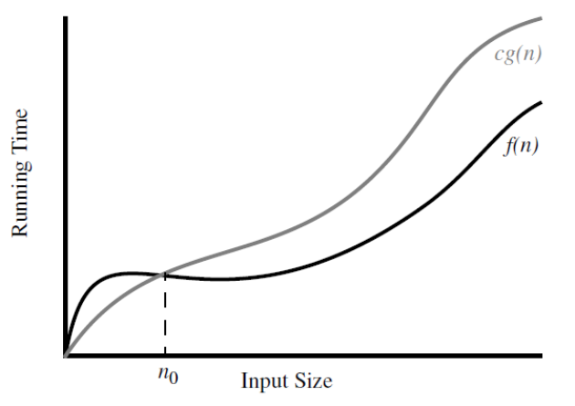
Definitions: Big Ο
Worst Case Scenario
Upper-bound of a function f(n)
Let f(n) and g(n) be functions mapping positive integers to positive real numbers. We say that f(n) is O(g(n)) if
  there is a real constant c > 0 and
  an integer constant n0 ≥ 1 such that
f(n) ≤ c g(n), for n ≥ n0.
f(n) is O(g(n))

Slide 4
Big Ο Rules
Simplifications:
If is f(n) a polynomial of degree d, then f(n) is O(n^d), i.e.,
  Drop lower-order terms
  Drop constant factors
Use the smallest possible class of functions
  Say “2n is O(n)” instead of “2n is O(n^2)”
Use the simplest expression of the class
  Say “3n + 5 is O(n)” instead of “3n + 5 is O(3n)”

Slide 5

Time Complexity Calculation n²
O(N²) = (100)² ⁼ 10000

Slide 6
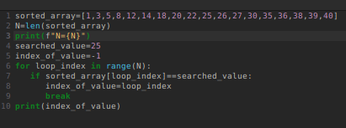
Time Complexity Calculation n
O(N) = (100) ⁼ 100

Slide 7
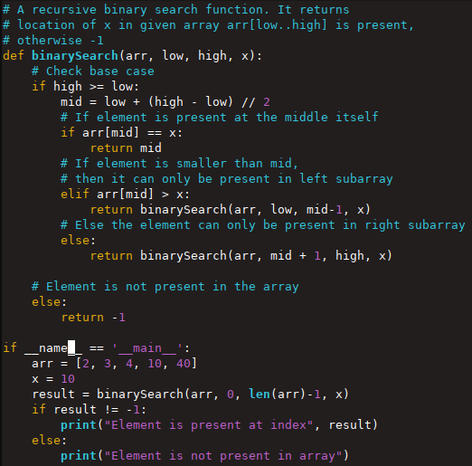
Time Complexity Calculation log(n)
Binary Search Algorithm
O(log2(N)) = log2(100)
MASTER THEOREM :
(Complexity for Recursive Algos.)
T(N) = aT(N/b) + f(N)
a = recursive call
b = divided sub problems
f(N)= complexity of one loop/call step
T(N) = T(N/2) + O(1)
→ Apply the rule in theorem.

Slide 8
Basics
Name | Function | Relation | Example
Constant Time | f(n) = c | Does not depend on input size. | Accessing array elements.
Logarithmic Time | f(n) = log n | Running time increases logarithmically with the input size. | Binary search.
Linear Time | f(n) = n | Running time increases linearly with the input size. | Iterating through an array or list.
Linearithmic Time | f(n) = n log n | The running time grows slower than O(n^2) but faster than O(n). | Efficient sorting algorithms like quicksort and mergesort.
Quadratic Time | f(n) = n^2 | Running time grows proportionally to the square of the input size. | Algorithms with nested loops, such as selection sor tor bubble sort.
Polynomial Time | f(n) = n^k | Running time is a polynomial function of the input size. | Algorithms with “k” nested loops.
Exponential Time | f(n) = 2^n | Running times that grow very rapidly with the input size. | N-P complete problems, such as traveling salesman.

Slide 9
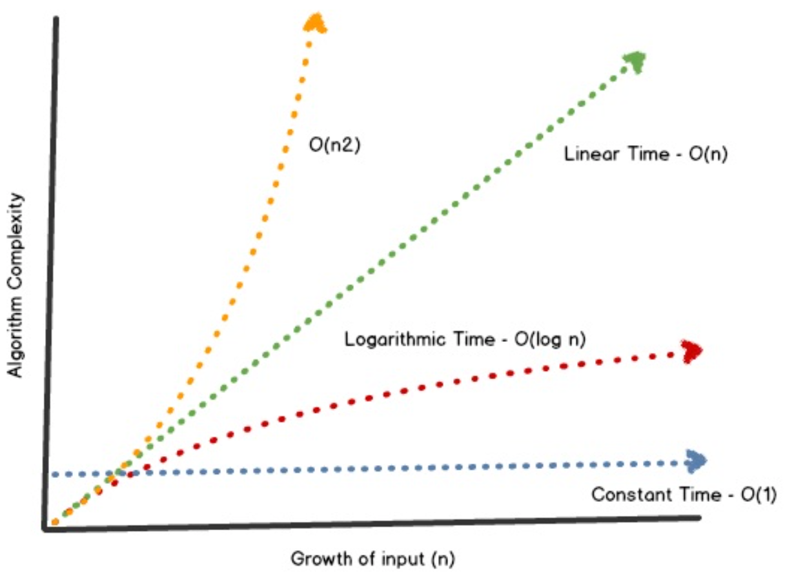
Growth Rates

Slide 10
Examples:
7n-2 is O(n)
3n³ + 20n² + 5 is O(n³)
3 log n + 5 is O(log n)

Slide 11
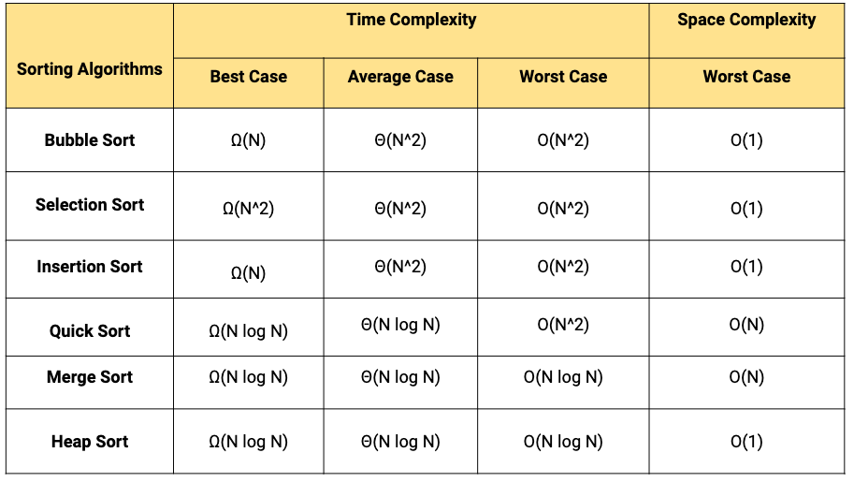
Example : Complexity of Search Algorithms

Slide 12
Bubble Sort – algorithm
def bubbleSort(arr):
n = len(arr)
# Traverse through all array elements
for i in range(n):
swapped = False
# Last i elements are already in place
for j in range(0, n-i-1):
# Traverse the array from 0 to n-i-1
# Swap if the element is greater than the next element
if arr[j] > arr[j+1]:
arr[j], arr[j+1] = arr[j+1], arr[j]
swapped = True
if (swapped == False):
break
Time Complexity: O(n²)
Auxiliary Space: O(1)

Slide 13
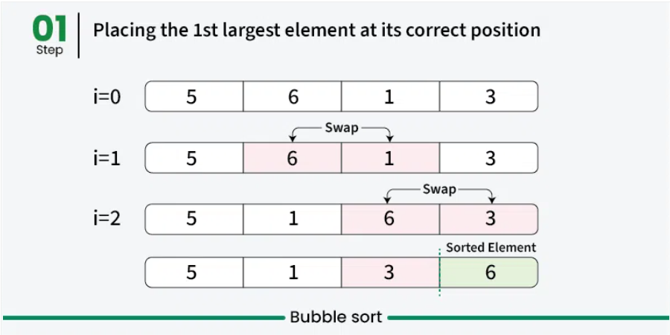
Bubble Sort

Slide 14
Merge Sort
def merge(left, right):
result = []
i = j = 0
while i < len(left) and j < len(right):
if left[i] < right[j]: result.append(left[i]); i += 1
else: result.append(right[j]); j += 1
result.extend(left[i:])
result.extend(right[j:])
return result
def mergeSort(arr):
step = 1 # Starting with sub-arrays of length 1
length = len(arr)
while step < length:
for i in range(0, length, 2 * step):
left = arr[i:i + step]
right = arr[i + step:i + 2 * step]
merged = merge(left, right)
# Place the merged array back into the original array
for j, val in enumerate(merged): arr[i + j] = val
step *= 2 # Double the sub-array length for the next iteration
return arr
unsortedArr = [3, 7, 6, -10, 15, 23.5, 55, -13]
sortedArr = mergeSort(unsortedArr)
print("Sorted array:", sortedArr)
Time Complexity: O(n logn)
Auxiliary Space: O(n)

Slide 15
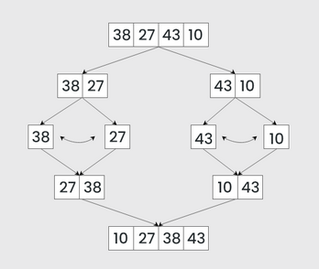
Merge Sort

Slide 16
Real Life Complexity Reduction Strategies
Use a mathematical formula, if there exists :)
Choose Efficient Algorithms :
  Depends on problem type : Try to find the name of your problem in literature, then search for the efficient algorithms for that specific problem.
  Breath First Search vs Depth First Search
  Don’t trust what ChatGPT says, these are just suggestions.
Use appropriate data structures ( E.g. Lists, Double Linked Lists, Trees, Hash Maps, …)
Implement Caching Mechanisms

Slide 17
Real Life Complexity Reduction Strategies
Try to apply Divide And Conquer method to your problem ( E.g. Merge Sort)
Try to apply Dynamic Programming algorithms to your problem ( E.g. Traveling Slaesman problem / Dijkstra Algorithm)
Try to use Memoization (store intermediate results)
  One of the reasons for GPU RAM PROBLEM :)
Try to use Big Data Algorithms like MapReduce

Slide 18


Example : Fibonacci Numbers
Example : Fibonacci Numbers : an=an-1+an-2
a100000=?
Math : Binet’s Formula (Generating Functions) O(log(n))
Algorithm : Find an algorithm that calculates faster with less resource :
def nth_fibonacci(n):
if n <= 1: return n
return nth_fibonacci(n - 1) + nth_fibonacci(n - 2)
print(nth_fibonacci(5))
F_n=0 ; F_n_1=2; F_n_2=1
n=5
for in range(n):
F_n = F_n_1 + F_n_2
F_n_2=F_n_1
F_n_1=F_n
print(F_n)
O(2^{n})
O(n)
Notes:
Efficiency: Data structures and algorithms are fundamental to writing efficient code. They help optimize operations like searching, sorting, and accessing data, which is critical for software performance.
Problem Solving: They provide a structured approach to problem-solving. By understanding different data structures and algorithms, programmers can choose the right tools to solve specific problems effectively.
Resource Management: Efficient data structures and algorithms are essential for managing system resources like memory and processing power. Poorly designed code can lead to resource wastage and performance issues.
Scalability: As data sets and user loads grow, scalable data structures and algorithms become increasingly important. They ensure that software can handle increased demands without a significant loss of performance.
Code Reusability: Proficiency in data structures and algorithms enables developers to create reusable code components. These components can be used across various projects, saving time and effort.
Problem Classification: Knowledge of data structures and algorithms helps in categorizing and understanding different types of problems. This classification can guide developers in choosing appropriate solutions.
Competitive Programming: For those interested in competitive programming or coding competitions, a strong understanding of algorithms is a must. These contests often involve solving complex problems under tight time constraints.
Interviews and Job Opportunities: Many tech job interviews assess candidates' knowledge of data structures and algorithms. A solid understanding can significantly improve your prospects in the job market.
Machine Learning and Data Science: Data structures are vital in handling and manipulating large datasets in fields like machine learning and data science. Algorithms are used for data analysis, pattern recognition, and more.
Foundation for Advanced Topics: Data structures and algorithms serve as a foundation for more advanced topics in computer science, such as artificial intelligence, cryptography, and database management systems.
Critical Thinking and Problem-Solving Skills: Learning data structures and algorithms fosters critical thinking and problem-solving skills. It encourages programmers to break down complex problems into manageable components.

Slide 19
Time-Space Complexity Trade-off
Time Complexity : Recalculate the values in each step of computation.
Space Complexity: Cache the calculated values and use pre-calculated values if possible.
Compressed or Uncompressed data
Re Rendering or Stored images
Smaller code or loop unrolling
Lookup tables or Recalculation

Slide 20
Access Times
CPU Speed = 1 cycle ( 1 cycle = 0.3 ns for a 3GHz CPU)
CPU Register = 1 cycle
L1 Cache = 3 cycles
L2 Cache = 10 cycles
L3 Cache = 40 cycles
RAM = 100 cycles
SSD = 10K cycles
HDD = 10M cycles

Slide 21
Exercises
Book: R-3.1

